Slide 1
Decoders: SIC, MMSE, MPA
What are decoders?
Essentially the receiving section is called decoders.
Purpose?
Receive the signal and try to determine the symbol/ bit that was transmitted.
Types
SIC – Successive Interference Cancellation
MMSE- Minimum Mean Square Cancellation
MPA- Message passing algorithm.

Slide 2
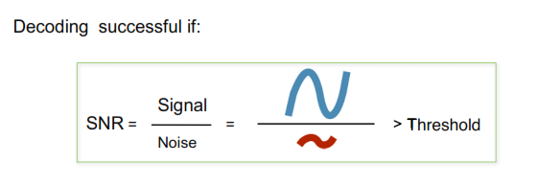
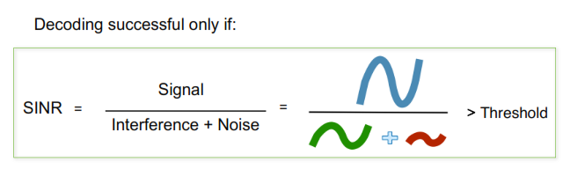
Main decoding issues:
Interference –Addition of unwanted signal to useful signal.
Types:- Co-channel and adjacent channel Interference.
Channel noise- Addition of unwanted random signal to useful signal.
Decoding in the absence of interference VS presence of interference

Slide 3
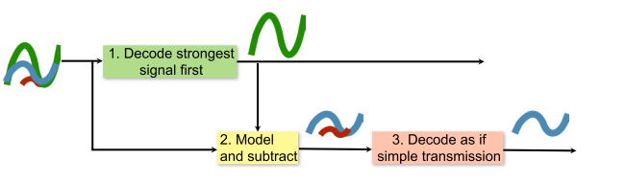
How to decode in the presence of Interference?
SIC comes to the rescue. We can employ SIC in order to remove the interference signal and help with successful transmission
Thus with SIC it is as if we can obtain “uncorrelated” signal, thereby resulting in two successful transmissions. This favours increased capacity and also provides more room for transmission of signals

Slide 4
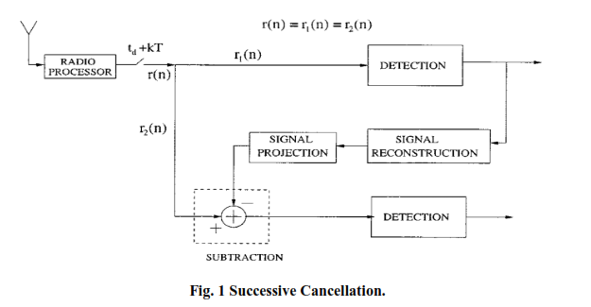
Basic successive cancellation, involving detector, signal reconstruction.
Weaker Signal is later on subtracted from the original to obtain better estimate of the stronger signal.
If the incoming signals have misalignment, this system fails to tackle it.

Slide 5
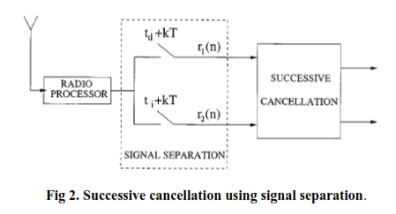
Works better than the previous system both for co-channel and adjacent channel interference
Separating the individual base band by using different sample period for both the signals, so that the successive cancellation performs better.

Slide 6
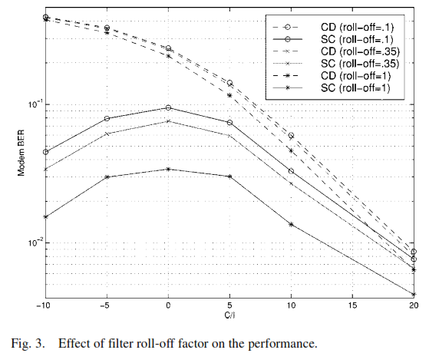
Shows the BER performance of successive cancellation
(SC) against conventional demodulator (CD).
when there is misalignment, successive cancellation using soft subtraction performs better than the CD

Slide 7
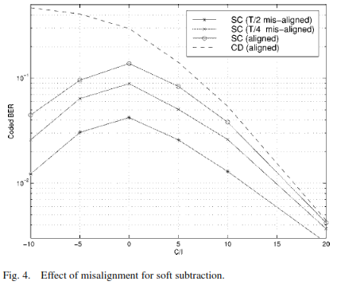
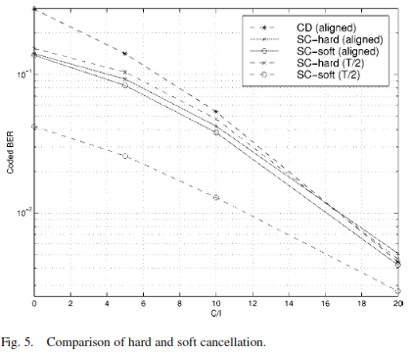
Fig. 5 shows the performance of SC using soft and hard subtractions. Soft subtraction improves the performance of successive cancellation. The more misaligned the signals are the larger is the gain of that system.
Fig.4 shows the effect of misalignment for SC. Misalignment helps to increase signal separability prior to successive cancellation. Consequently this improves the performance of successive cancellation schemes.

